Slide 1
Note 13 Database Performance Tuning Using Index
CSC134
Dr. Haiquan Chen

Slide 2
Creates an index on a table
CREATE INDEX index_name ON table_name (column_name)
For example, the SQL statement below creates an index named "PIndex" on the "LastName" column in the "Persons" table:
CREATE INDEX PIndex ON Persons (LastName)

Slide 3
Creates an index on a table
You can also create an index on a combination of columns, by listing the column names within the parentheses, separated by commas.
CREATE INDEX PIndex ON Persons (LastName, FirstName)

Slide 4
Performance tuning using index
If a column does not have an index on them, a full-table scan occurs
To speed up data search/queries, create index on columns that are used in WHERE clause of an SELECT statement to avoid a full-table scan.
By default, MySQL will create an index named “PRIMARY” on the primary key in each table.

Slide 5
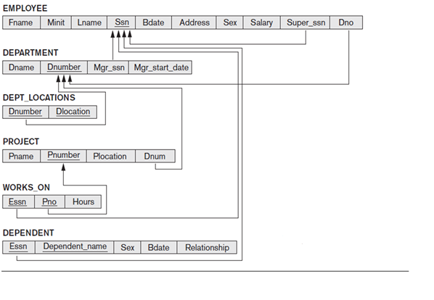
Example: COMPANY Database

Slide 6
Where to create index?
Query: Retrieve all employees in department 5 whose salary is between $30,000 and $40,000.
Select *
From employee E
Where E.dno=5 and (E.salary >= 30000 and E.salary<=40000)

Slide 7
Where to create index?
Query: Find the sum of the salaries of all employees for the research department, as well as the max salary, the min salary and the average salary.
Select sum(E.salary), max(E.salary), min (E.salary), avg(E.salary)
From employee E, department D
Where E.dno =D. dnumber and D.dname=’Research’

Slide 8
Don't overuse index!
Updating a column with index takes more time than updating a column without index (because the indexes also need an update).
So you should only create indexes on columns that will be frequently searched against.

Slide 9
Some times only using index does not help too much…
You need to tune the performance by re-design/re-structure your database. This process is referred to as database normalization.

